Slide 1
Муниципальное бюджетное образовательное учреждение «Талинская средняя общеобразовательная школа»
Учитель иностранного языка: Яметова Ольга Николаевна
«Использование ЦОР на уроках иностранного языка для обучения функциональной грамотности»

Slide 2
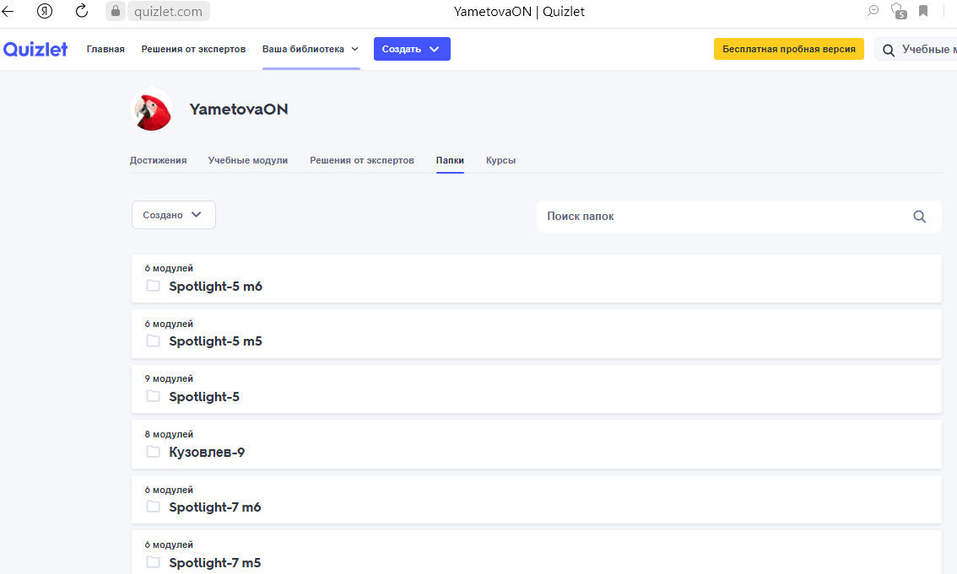
Решение проблемы ++
Создание цифровых карточек
Интерфейс + +
Свои модули + наработки учителей
https://quizlet.com/YametovaON/folders

Slide 3
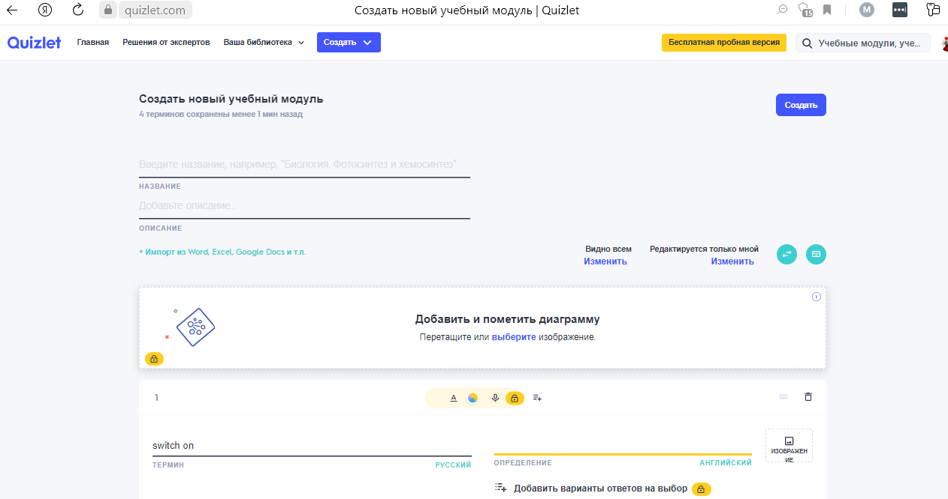

Slide 4
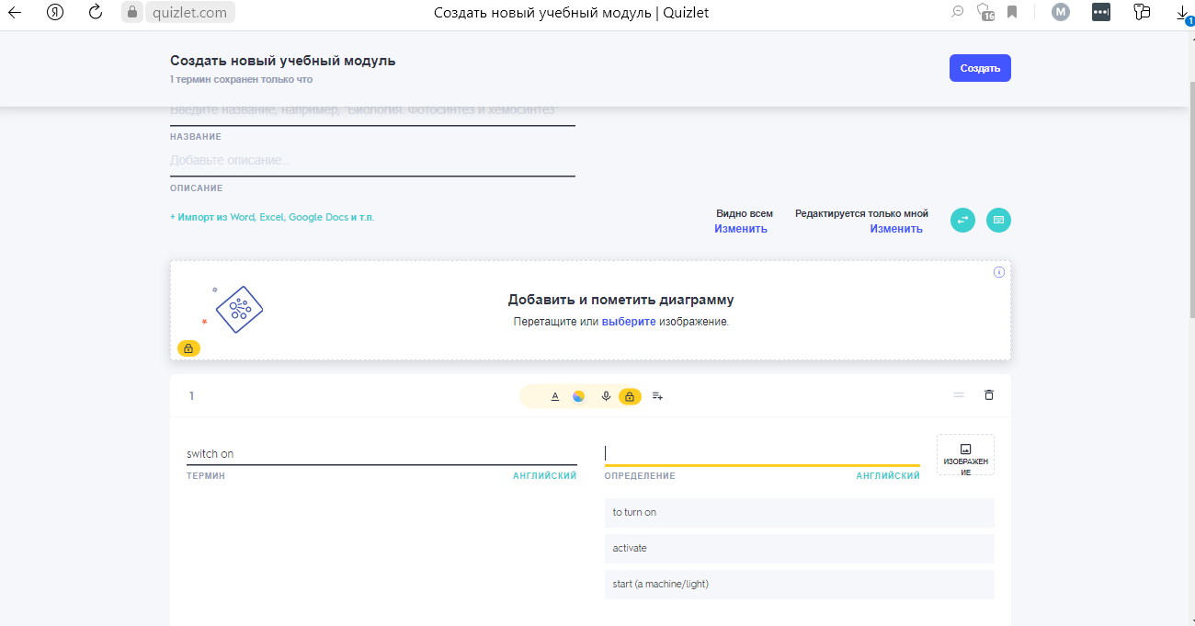

Slide 5
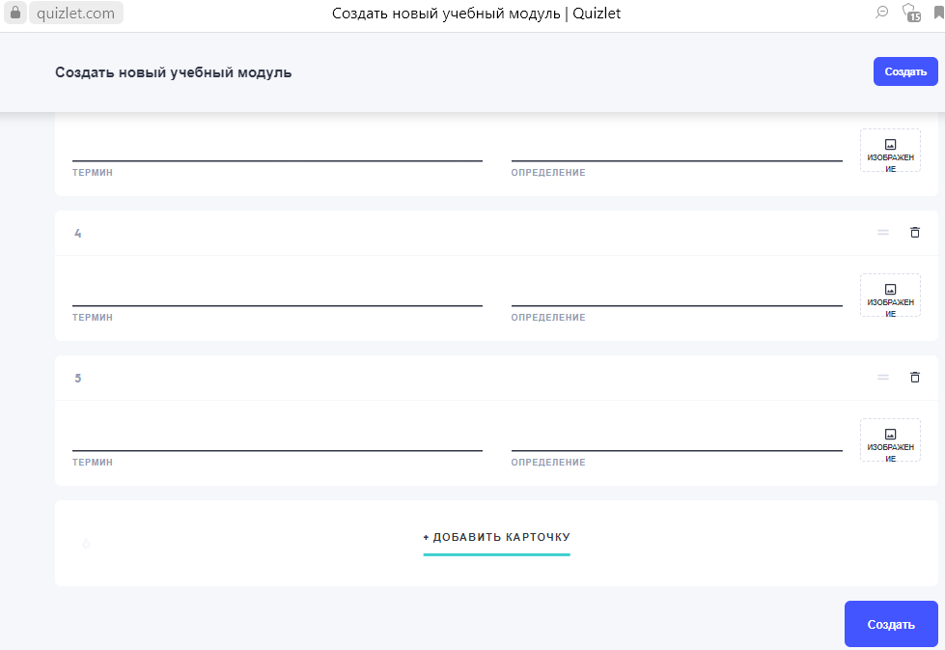

Slide 6
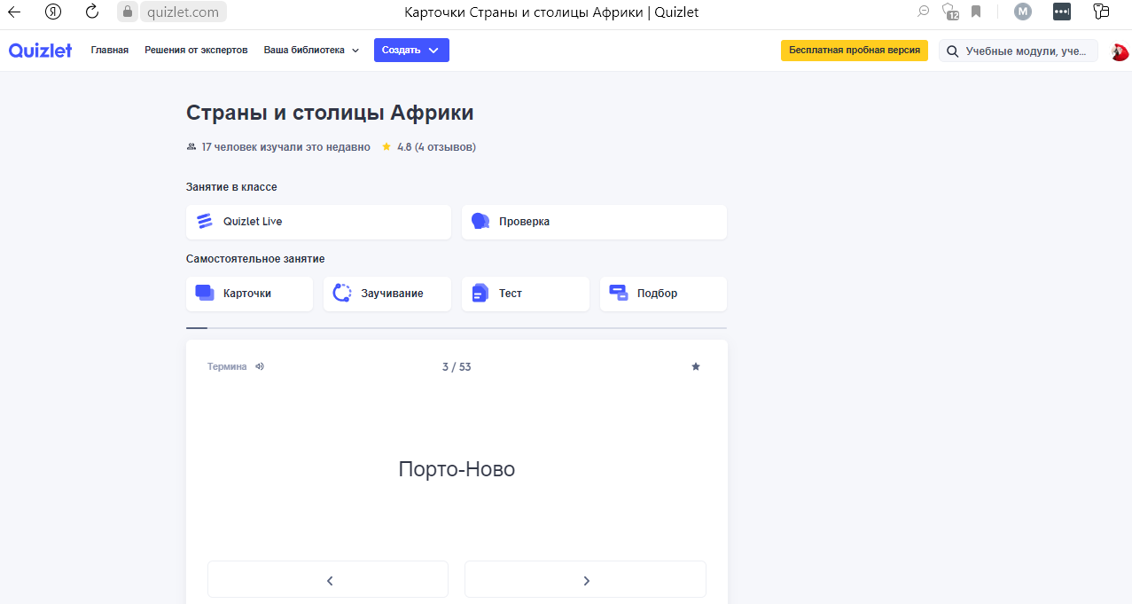

Slide 7
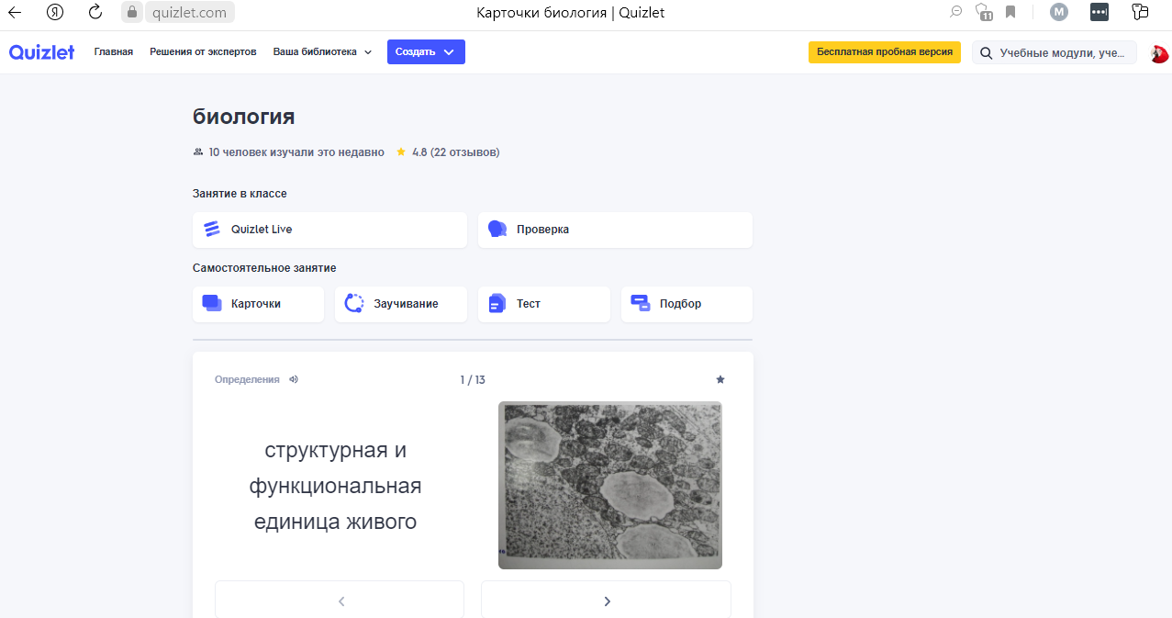

Slide 11
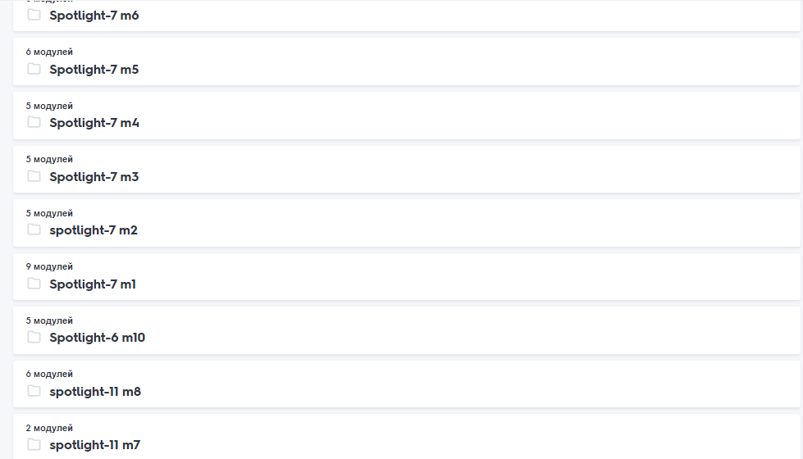

Slide 12
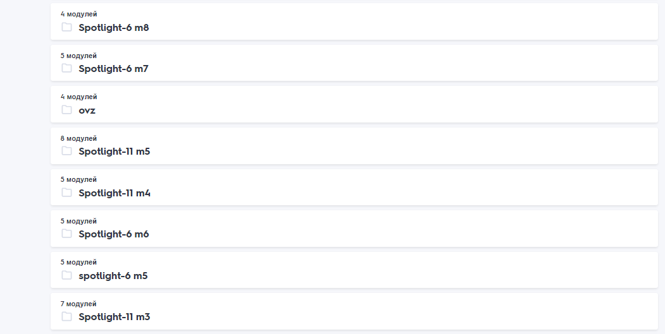

Slide 13
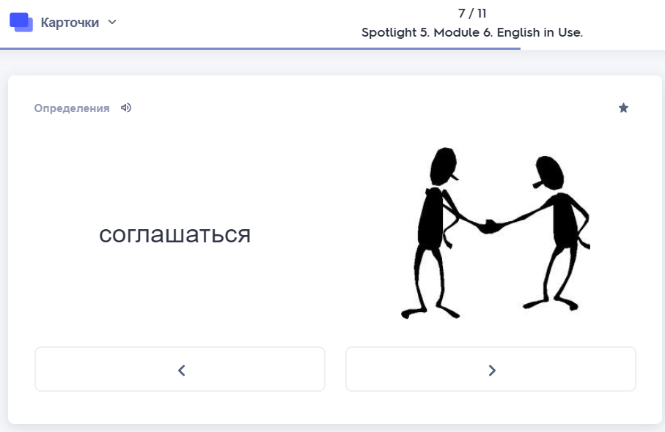
+--

Slide 15
https://quizlet.com/ru/735335946/Кузовлев-9-unit-2-lessons-1-2-definitions-flash-cards/?funnelUUID=cd8c7962-a103-4e50-b29f-70e3c91f18c3

Slide 18
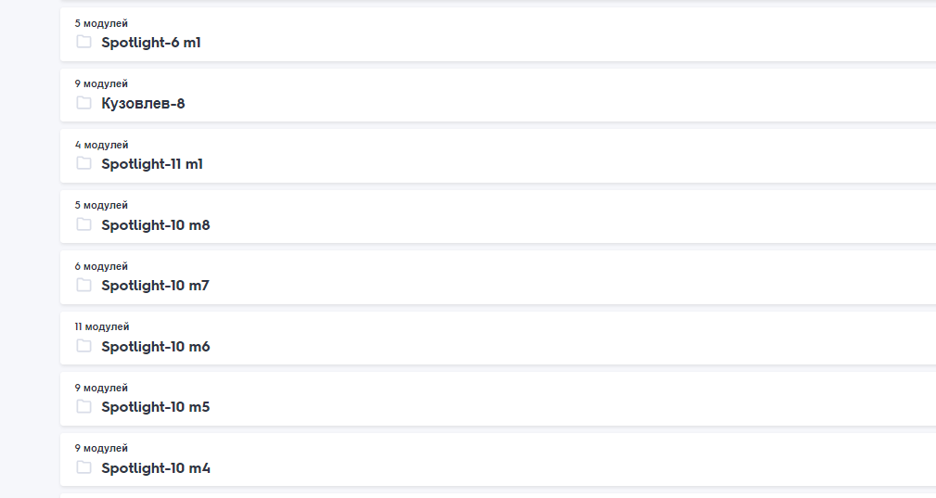
Поиск через браузер

Slide 19
https://wordwall.net/ru/resource/7993943/spotlight-4a-my-family

Slide 20
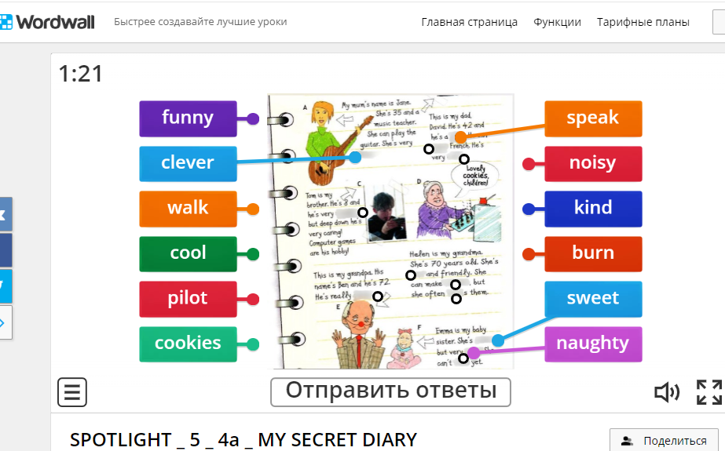
https://wordwall.net/ru/resource/26084197/english/spotlight-5-4a-my-secret-diary

Slide 21
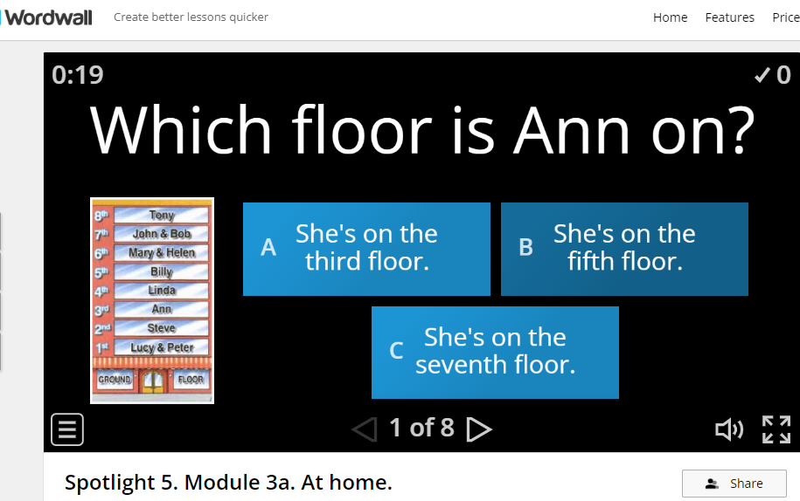
https://wordwall.net/ru/resource/26084197/english/spotlight-5-4a-my-secret-diary

Slide 23
https://test-english.com/grammar-points/a1/present-simple-forms-of-to-be/

Slide 24
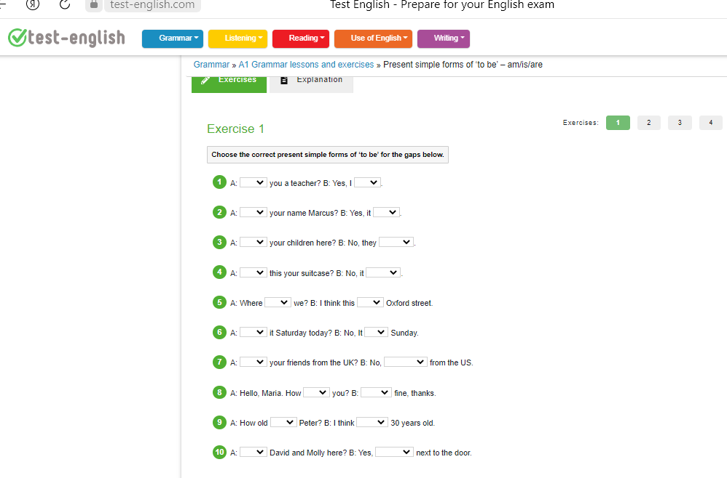

Slide 25
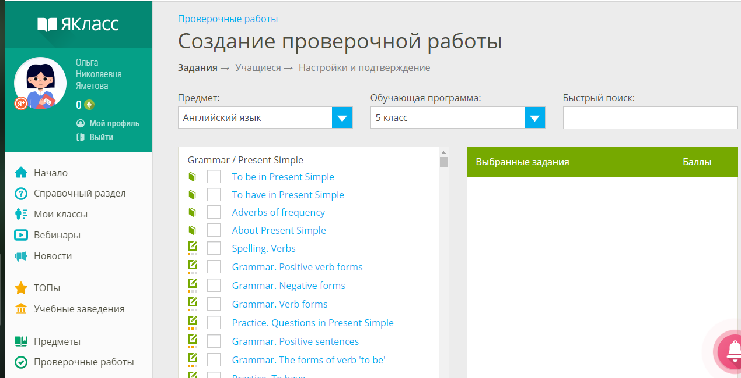

Slide 26
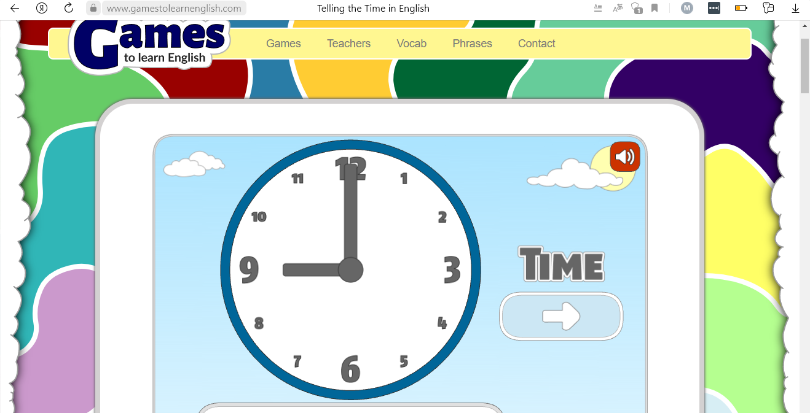

Slide 27
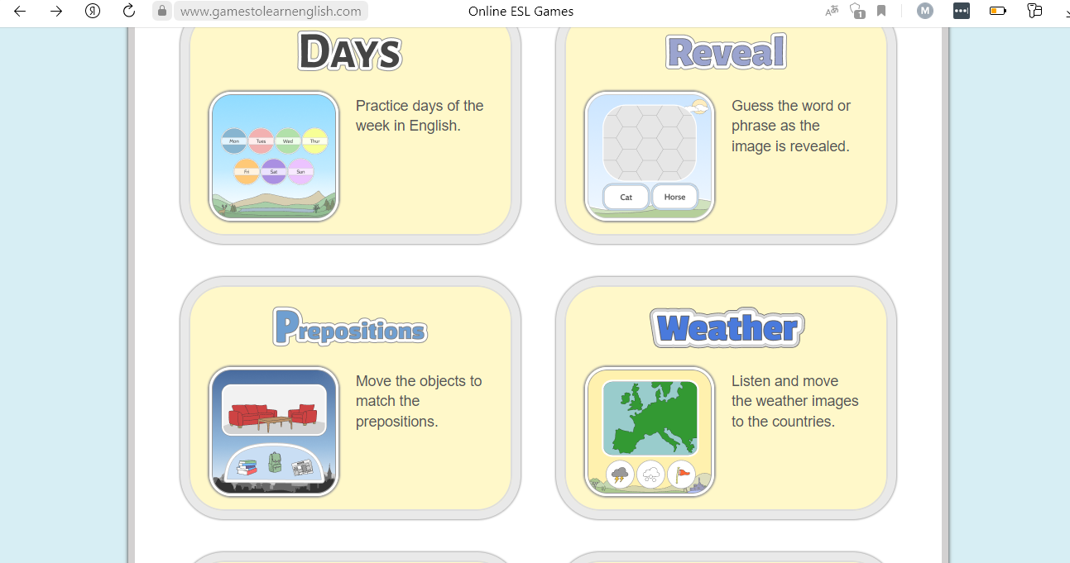

Slide 28
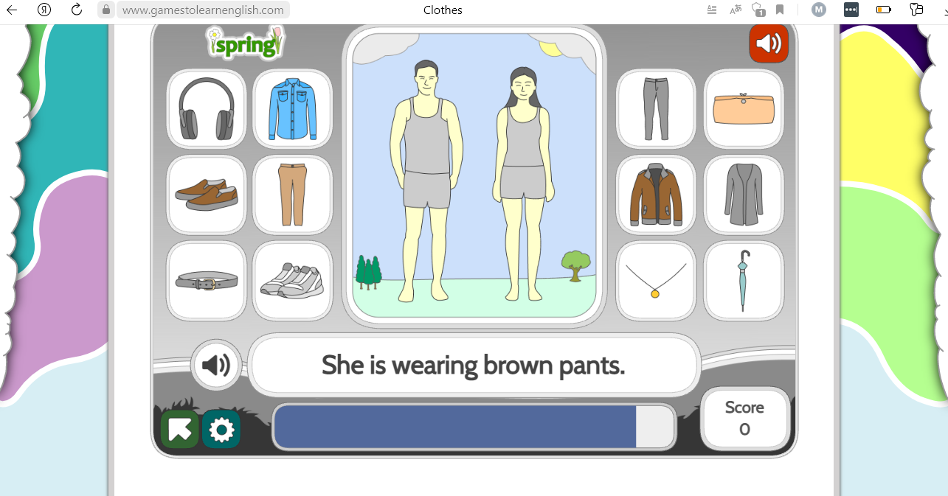

Slide 29
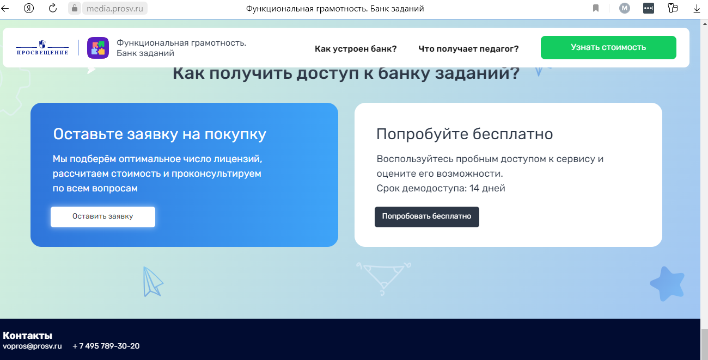

Slide 32
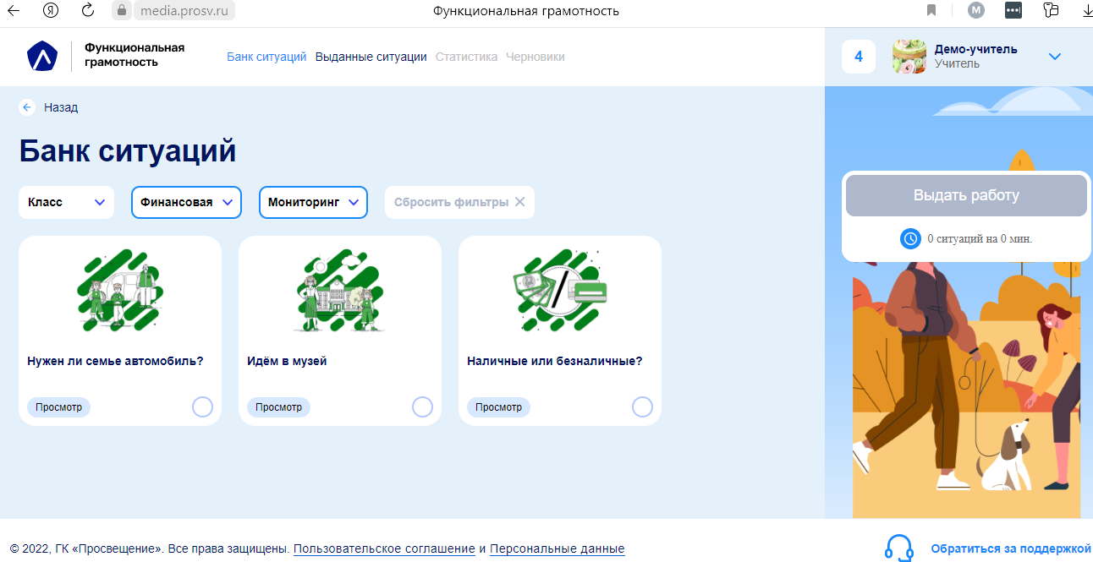

Slide 33
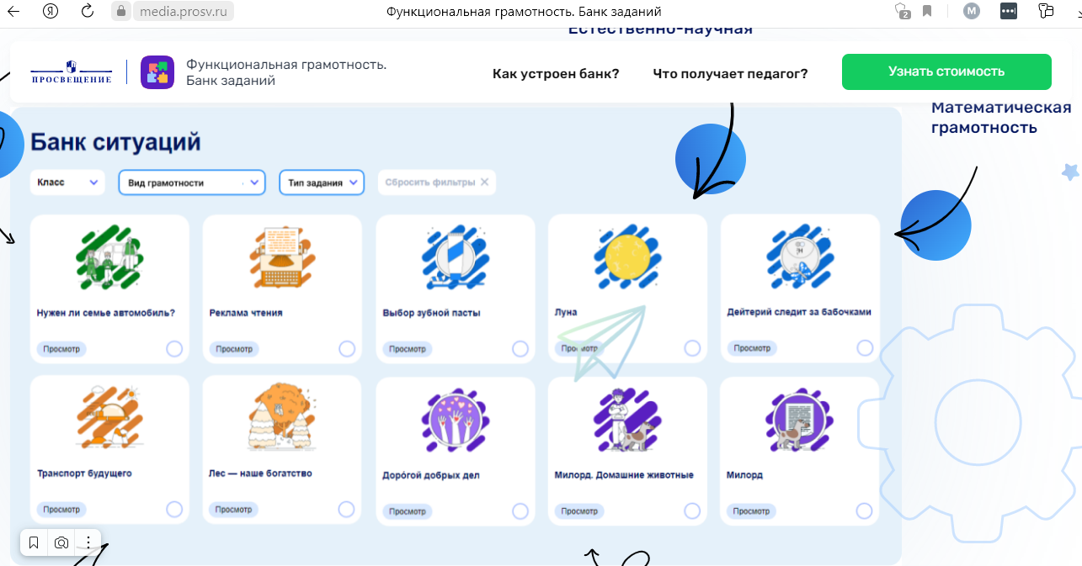

Slide 34
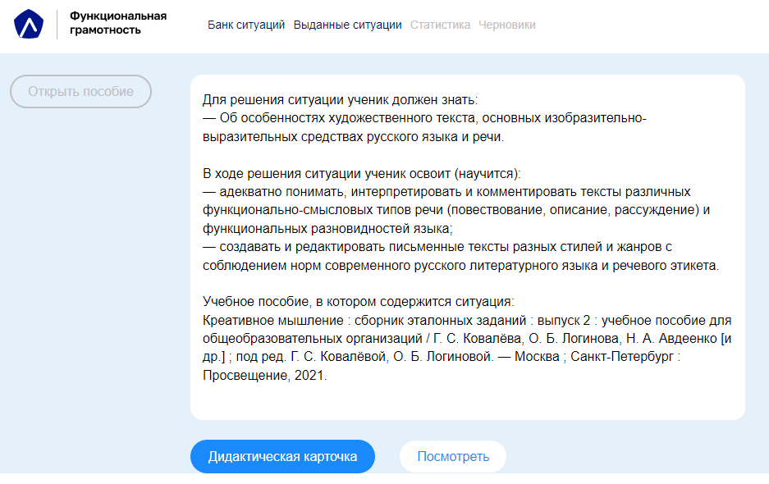

Slide 35
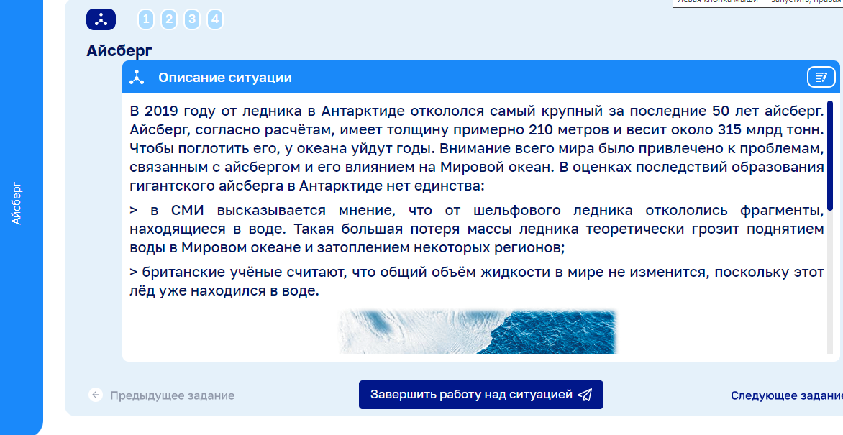

Slide 36
Iceberg
Description of the situation
In 2019, the largest iceberg in the last 50 years broke off from a glacier in Antarctica. The iceberg, according to calculations, has a thickness of about 210 meters and weighs about 315 billion tons. It will take years for the ocean to absorb it. The attention of the whole world was drawn to the problems associated with the iceberg and its impact on the oceans. There is no unity in the estimates of the consequences of the formation of a giant iceberg in Antarctica:
there is an opinion in the media that that fragments broke off from the ice shelf. Such a large loss of glacier mass theoretically threatens to rise water in the world Ocean and flooding of some regions;
British scientists believe that the total volume of liquid in the world will not change, since this ice was already in the water.
Iceberg
Previous task
Finish working on the situation
Next task

Slide 37
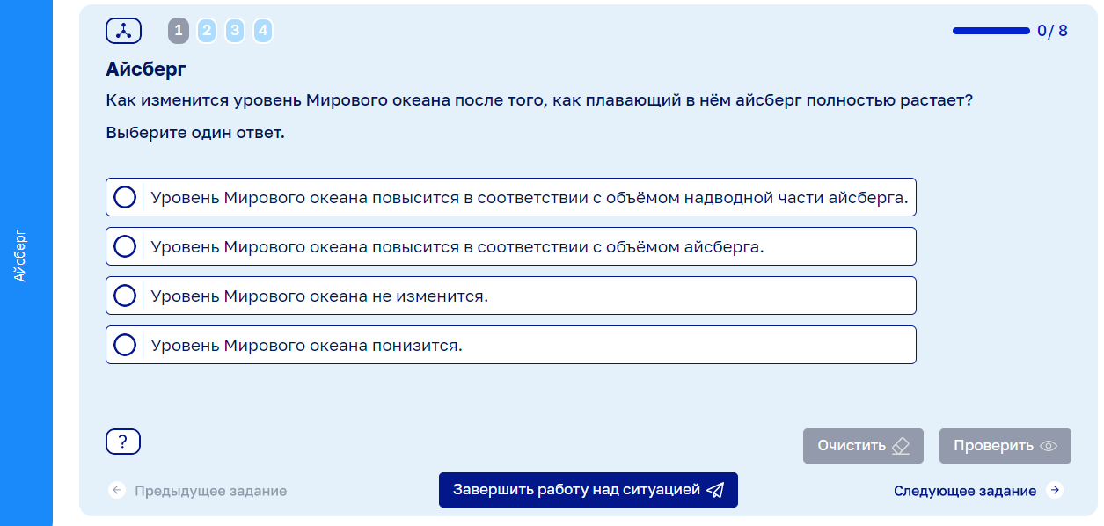

Slide 38
Iceberg

Slide 39
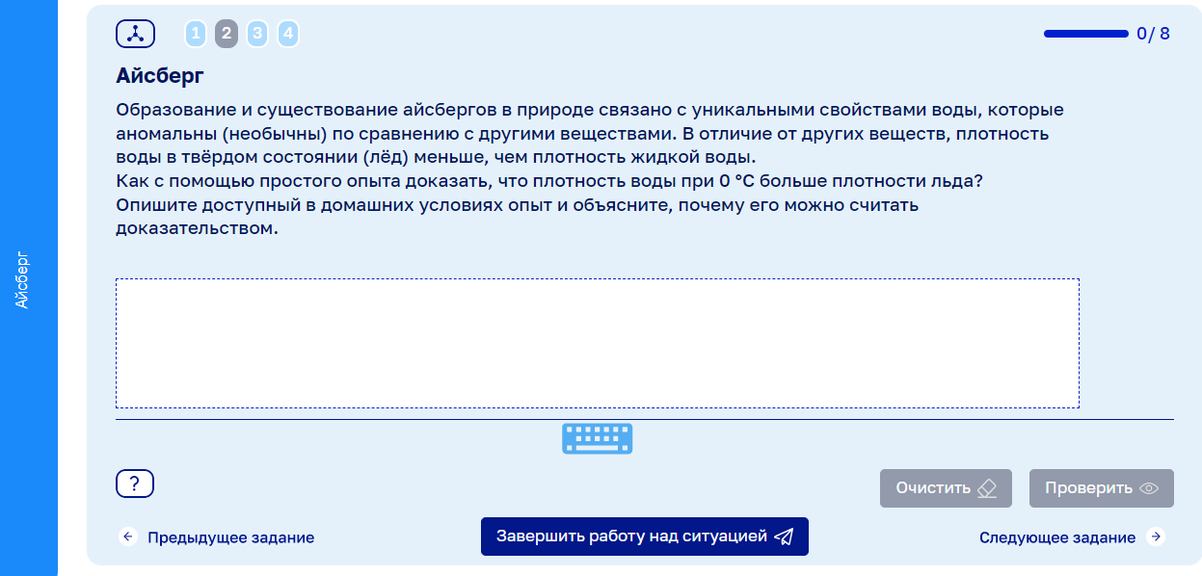

Slide 40
Iceberg

Slide 41
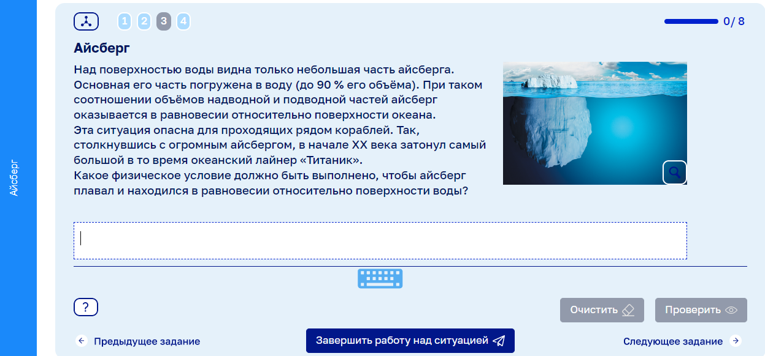

Slide 42
Iceberg

Slide 43
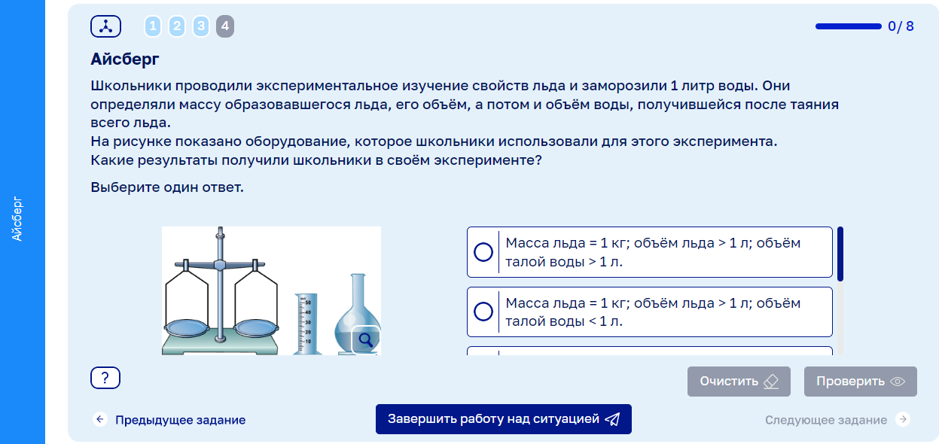

Slide 44
Iceberg

Slide 45
task # 1.The correct answer is: B. The level of the world Ocean will not change. Evaluation criteria: 2 points: B. The level of the World Ocean will not change.
0 points: Other answer options.

Slide 46
2) task # 2.Right answer: An experience is described when pieces of ice taken out of the refrigerator float on the surface of the water and do not sink. And an explanation is given that according to the law of floating bodies, a body does not sink in a liquid if its density is less than the density of the liquid. Evaluation criteria:2 points (the answer is accepted in full): An experience is described when pieces of ice taken out of the refrigerator float on the surface of the water and do not sink. And an explanation is given that according to the law of floating bodies, a body does not sink in a liquid if its density is less than the density of the liquid.1 point (the answer is partially accepted): Only a description of the experience is given (see above) without explaining why this experience can be considered proof.0 points: Other answers.

Slide 47
3) task number 3.Correct answer: The condition is named: the gravity of the iceberg is equal to the buoyant force acting on it(or Archimedean power).Evaluation criteria:2 points: The condition is named: the gravity of the iceberg is equal to the pushing force acting on it(or the Archimedean force).0 points: Other answers.

Slide 48
4) task number 4.Correct answer:D. Ice mass = 1 kg; ice volume > 1 l; melt water volume = 1L.Evaluation criteria:2 points: D. Ice mass = 1 kg; ice volume > 1 l; melt water volume = 1L.0 points: Other answers.

